Slide 1
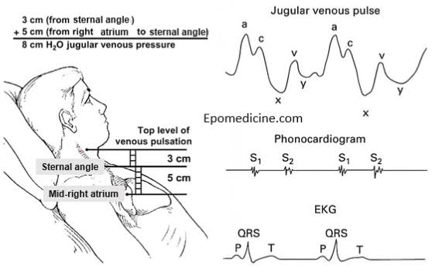
JUGULAR VENOUS PULSE
Dr AJMAL

Slide 2
REFERENCES
Essentials of cardiac physical diagnosis by JONATHAN ABRAMS.
Essentials of bedside cardiology by JULES CONSTANT.
Textbook of medical physiology by GUYTON and HALL 12th edition.
Harrison's Principles of Internal Medicine 21st edition.
BraunwaldsHeart disease 12th edition.

Slide 3
CONTENT
Part 1: Anatomy and Physiology
Part 2: Normal wave forms
Part 3: Abnormalities
Part 4: Special situations

Slide 4
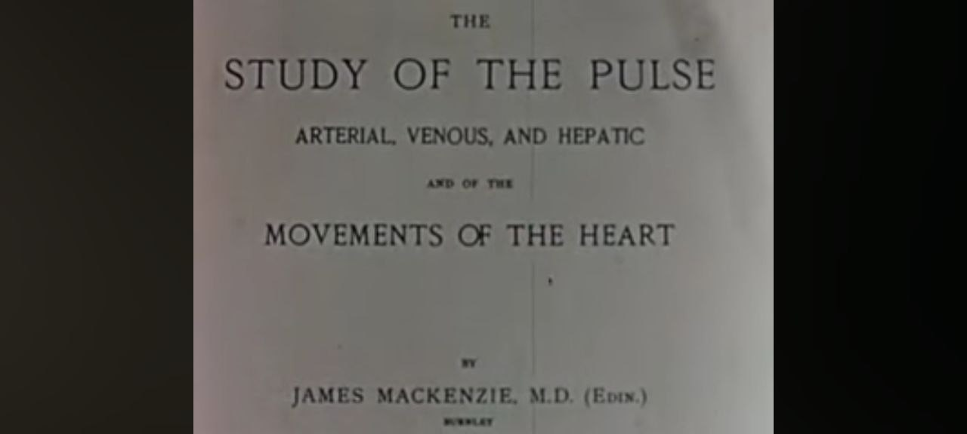
HISTORY behind JVP
Giovanni Maria Lancisi, described the systolic fluctuations in Jugular vein in a patient with tricuspid regurgitation.
Later CV waves of TR was named as Lancisi sign or Venous corrigans.
Sir James Mackenzie (Father of British Cardiology), named the waves of JVP.

Slide 5
He invented a machine to simultaneously trace carotid pulse and JVP.

Slide 6
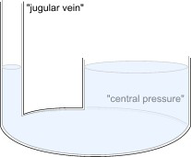
PHYSIOLOGY
Venous system contains about 70 to 80 % of the circulating blood volume.
Still it maintains a very low intravascular pressure i.e. 3 to 7 mmHg because the veins are extremely distensible
JVP reflects the relationship between venous tone , the volume of blood in the venous system and right heart hemodynamics

Slide 7
During diastole the jugular veins directly reflect right ventricular filling pressure
During systole they reflect right atrial pressure
Thus analysis of JVP provides considerable information about right sided cardiac physiology.
LV pumping: Pulse
LV filling: ?
RV pumping: ?
RV filling : JVP

Slide 8
Jugular venous pressure represents the volumetric changes
that faithfully reflect the pressure changes in the right side of heart.
Oscillating top of the distended proximal portion of the
internal jugular vein (IJV) is used for measurement.
Indirect venous pulsation of the internal jugular vein is transmitted to the overlying skin and soft tissues with a subtle and undulant motion-seen as JVP

Slide 9
ANATOMY

Slide 11
WHY NOT EJV
External jugular vein
pulsations prevented by prominent valves at the proximal EJV.
structures of neck and upper thorax causes extrinsic compression
Sympathetic vasoconstriction of EJV
Internal jugular vein
Anatomically closer to RA.
Take a direct course (‘straight
line’) to SVC and RA.
More accurately reflect the
dynamics of the Right Heart.
└
The external jugulars communicate with the superior vena cave after two near 90° turns, one where the external jugular enters the subclavian and another where the subclavian enters the superior vena cava.

Slide 12
Why Prefer Right over Left
Right IJV
Straight line course through innominate vein to the SCV and RA.
Less likely extrinsic compression from other structures in neck.
Left IJV
Drains into left innominate vein, which is not in straight line from SVC and RA.
Left innominate vein may be compressed by dilated aorta or an aneurysm.
Will you ever use Left IJV for measuring JVP?
Central venous catheter on Rt IJV
Thrombosis of Rt IJV
Large thyroid mass on Rt side

Slide 13
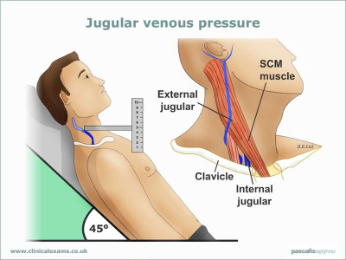
METHOD OF EXAMINATION OF JVP
1.Patient should lie comfortably
2.Trunk is inclined at required angle
3.Elevate chin and slightly rotate head to left
4. Neck and trunk should be in same line
5.Relax neck muscles and shine a beam of light (tangential) to see neck pulsations
6.Look for pulsation inbetween the 2 heads of sternomastoid and for transmitted pulsation from below SCM from clavicle up to angle of mandible.

Slide 14
Examined in ANY position in which top of the column is seen easily.
In normal subjects and most patients with heart disease - 45⁰.
In patients with high venous pressure, a greater (60-90⁰) inclination is required to obtain visible venous pulsations.
Simultaneous palpations of the left carotid artery or cardiac ausculation aids in timing of the JVP in cardiac cycle

Slide 15
Starting Point: Middle of Rt atrium (Phlebostatic axis)
End Point is the highest point in venous column.
Sternal angle is at 5cm from the middle of right atrium (fixed in all positions).
In a normal person the highest point of venous column in the neck will be at <3cm from Sternal angle.
JVP=5+(0 to 3)=5 to 8cm H2O which is approximately=7mmhg venous pressure
1cmH2O=0.756mmHg

Slide 17
Is this method accurate
The distance from sternal angle to the level of mid right atrium varies considerably with the patients position and between individuals.
SA-RA distance variations between patients were found to be significant and was independently associated with age, smoking and AP diameter of chest

Slide 18
Hence general use of Sternal angle as reference leads to underestimation of Venous pressure.
In general, venous pulsations above the clavicle with the patient in sitting position is clearly abnormal.
Because the distance from right atrium to clavicle is atleast 10cm.

Slide 19
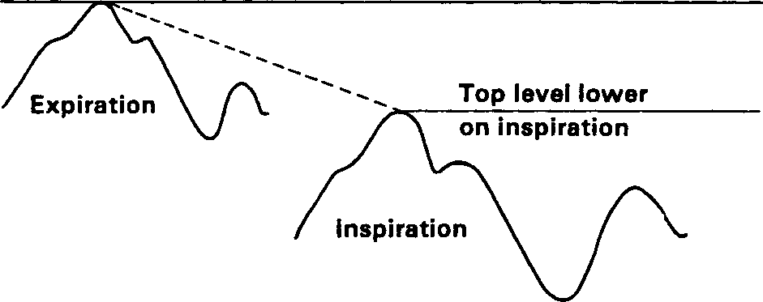
Should you look in Inspiration or expiration?
To determine the mean jugular venous pressure, the examiner should observe the
nadir of the venous column on inspiration and
then the crest of this column on expiration.
Midpoint of the excursion of the venous pulse during normal respiratory cycles is estimated visually.
Exaggerated breathing or breath holding distorts the normal mean venous pressure and should be avoided.

Slide 20
 | IJV | Carotid artery
Location | Low in neck ;lateral Between the two heads of SCM | Deep in neck ; medial In the carotid triangle
Contour | Double peaked | Single peaked
Character | Undulant , not palpable | Forceful , brisk , easily felt
Inspiration | A and V waves often more visible although mean pressure decreases | No change
Upright position | Decrease in mean pressure | No change
Compressibility | Readily obliterated by gentle pressure 3- 4 cm above clavicle | Cannot compress easily
Abdominal compression | May see transient increase in pressure | No effect

Slide 23
NORMAL WAVE FORMS

Slide 24
There are 2 visible peaks or waves and 2 visible descents or troughs in the normal jugular venous pulse
a wave is followed by x descent
v wave is followed by y descent
c wave is seen interrupting the x descent.
In small number of persons , a late h wave following y descent

Slide 25
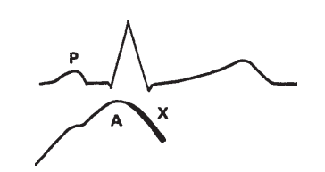
a wave
Directly reflects right atrial contraction
Results in retrograde blood flow into the superior venacava and jugular veins during RA systole
Most positive wave in JVP
Precedes the upstroke of carotid pulse
Just before S1 (related to S4)
Follows the P wave of ECG

Slide 26
X descent
Early portion results from RA relaxation during atrial diastole

Slide 27
c wave
It has two different causes
In the neck veins , the c wave is an artifact caused by transmitted carotid artery pulsations
In the right atrium the c wave reflects the upward bulging portion of the closed tricuspid valve during isovolumetric contraction.

Slide 28
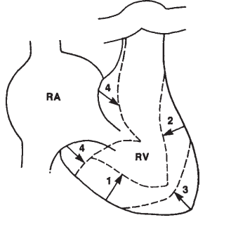
X’descent, the systolic collapse wave
The x’ descent reflects the fall in right atrial pressure during right ventricular systole - tricuspid valve ring is being pulled caudally by the contracting right ventricle. “Descent of the base”
As stroke volume is ejected, the ventricle takes up less space in pericardium, allowing relaxed atrium to enlarge.
Can be used as a measure of right ventricle contractility

Slide 29
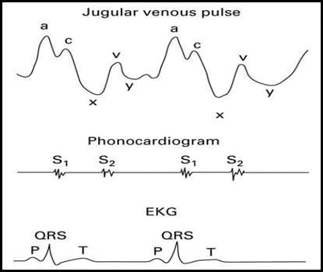
X descent is often the most prominent motion of the normal jugular venous pulse.
It is more prominant during inspiration.
It begins and ends in systole (ends before S2).

Slide 31
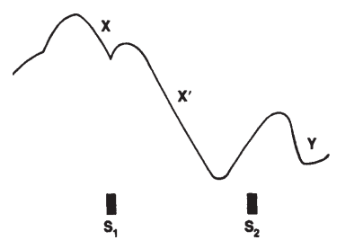
v wave
Second major positive wave
V wave results from continued venous inflow into the right atrium during ventricular systole while the tricuspid valve is closed
Begins in late systole
Peaks just after S2
ends in early diastole
V

Slide 32
y descent Diastolic collapse wave
Decline in RA pressure due to rapid emptying of the RA into the RV following the opening of the tricuspid valve in early diastole.
Begins and ends during diastole
Corresponds to S3

Slide 33
h wave
Follows the y descent and results from passive right heart filling during diastole
Seen when the diastole is prolonged and the heart rate is low.

Slide 36
ACTUAL V/S WHAT WE SEE

Slide 37
In normal persons the right atrial a wave is larger than v wave
the x descent is more prominent than the y descent.
It is easier to decipher descents rather than ascents because the jugular descents are larger and faster than the ascents.
This is because the X descent is due to RV contraction, which is rapid, and the Y descent is due to the rapid phase of RV expansion.

Slide 38
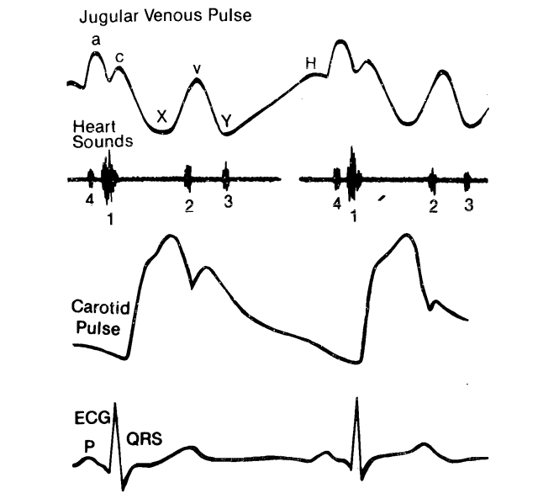
HOW TO TIME WAVES OF JVP
1.Peripheral pulse is palpated simultaneous with visual inspection of jugular veins.
Pulse and x descent- both are systolic events and hence will occur togather.

Slide 39
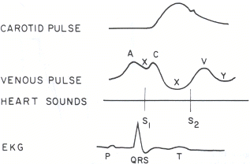
2. Jugular venous pulse with simultaneous auscultation of the heart sounds.
a wave: occur just before S1 (sharper and more prominent than ‘v’ wave).
x descent follows S1.
c wave: occurs simultaneously with carotid pulse, but never seen normally.
v wave: coincides with S2; less prominent than ‘a’ ascent.
y descent: follows S2.

Slide 42
How to make waves forms more visible
Try to increase the venous return by elevating the subject’s legs and having the subject take deeper breaths.
Deep inspiration can draw more blood into the right atrium, making movements of larger amplitude.
RA and RV contraction increase ( starling effect )
x and y descents become more exagerated
Although mean venous pressure falls slightly , the wave forms are accentuated during inspiration

Slide 43
THE ABDOMINAL COMPRESSION TEST
Hepatojugular Reflux/ Abdominojugular Reflux
Hepatojugular reflux- Historical term
This term was first applied in 1885, when it was thought that pressure on a large liver was an essential part of the test.
Actually, the effect can be achieved with a normal sized liver and with compression on any part of the abdomen, although pressure on the right upper quadrant produces the greatest response.
If the right upper quadrant is tender, compress on other area instead.

Slide 44
Indications:1.JVP is borderline elevated
2. Incipient RVF
3. Silent TR
Technique:
In the abdominal compression test, the patient is positioned so that the upper level of the venous column is at mid-neck level.
Gentle but firm compression on periumblical region with an open-fingered hand is applied for 30 to 60 seconds.
Patient should be instructed to continue breathing with an open mouth.

Slide 45
In a normal person transient (<15 sec) elevation of <1cm or no elevation may be seen when abdominal pressure is continued.
If JVP is elevated for >1 cm, which persist throughout the abdominal compression is a positive test.
Abdominal compression forces venous blood into the thorax.
A failing or dilated RV will not be able to recieve this extra amount of blood without elevation of mean venous pressure.
A positive test has been correlated with a pulmonary capillary wedge
pressure (left atrial pressure equivalent) of at least 15 mmHg.

Slide 46
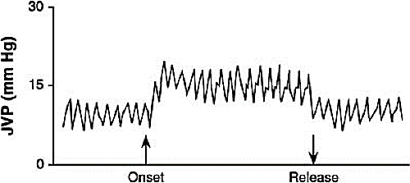
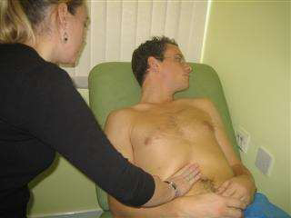
Causes osf Positive Abdominal Compression Test
Cardiac Causes Non cardiac causes
1.Incipient or actual RV failure 1.Obstructive Lung Disease
2.Biventricular Failure 2.Elevated sympathetic tone 3.Tricuspid Regurgitation (Systemic venoconstriction)
3.Fluid Overload

Slide 47
Kussmaul’s sign
Normally JVP will decrease with inspiration
Paradoxical increase or failure to fall with inspiration is called Kussmaul’s sign.
Causes: RCMP, Constrictive pericarditis, RV infarction, RHF, TS
Absent in Cardiac tamponade because, intrathoracic pressures are still transmitted to cardiac chambers.
Since RV fill well in inspiration , no increase in JVP during inspiration in tamponade.

Slide 49
ABNORMALITIES in JV PRESSURE
Normal Level - 6 to 8 cm H2O.
1)Decreased mean venous pressure (less than 5 cm H2O)
Hypovolemia
Dehydration
Hypotension
Shock

Slide 50
2)Increased mean venous pressure (greater than 9 cm H2O)-( impaired cardiac filling).
1.RV inflow impedence. (something is preventing RV to be filled normally.)
At the level of Tricuspid valve: Tricuspid stenosis
At the level of RV: RV failure, RV infarction, RVH, Pulm HTN, Pulm Stenosis,Constrictive pericarditis and Tamponade. (increase RV pressure)
2.Circulatory overload: Renal failure, Cirrhosis, Excess fluid administration.

Slide 51
Other causes include:
Increased abdominal pressure from any cause
Asthma , respiratory distress and emphysema may produce distended neck veins as a result of expiratory increases in intrathoracic pressure
Obstruction of SVC elevate the jugular pressure , however no venous pulsations or waveforms are seen and hepatojugular test will be negative.venous collaterals will be visible in the upper chest

Slide 52
Abnormalities in wave forms

Slide 53
Large a wave
Prerequisites:
1.Presence of atrial depolarisation
2.Responsive atrial myocardium
3.Intact IAS
4.Resistance to atrial emptying

Slide 54
Whenever the force of right atrial contraction is augmented , the a wave will increase and may become quite prominent.
Tricuspid level
Increased resistance to RA emptying
Increased RA contraction.
e.g. Tricuspid stenosis, RA myxomas, Tricuspid atresia.
RV Level
Decreased RV compliance/Elevated RVEDP
e.g:RVH (Pulmonary stenosis, PAH) Acute PE,Restrictivecardiomyopathy,RV infarction

Slide 55
Certain conditions causing marked LVH such as hypertrophic CMP , valvular AS , jugular a wave may be accentuated – due to the massively hypertrophied interventricular septum altering the pressure volume characteristics of RV ( Bernheim effect )
GIANT a Wave
a wave if it is higher than normal (Height over 4.5 cm above the sternal angle with the chest at 45°) due to too strong an atrial contraction.

Slide 56
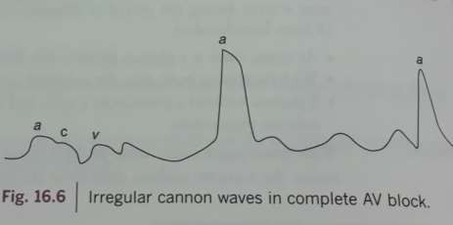
Cannon a waves
Cannon a waves are seen when atria is contracting against a closed ventricle.
Regular Cannon a waves are seen in
Junctional rhythm,
Isorhythmic AV dissociation,
Ventricular tachycardia 1:1 retrograde conduction
Irregular cannon a waves are seen in Classic AV dissociation
Complete heart block
Ventricular tachycardia
Ventricular ectopy
Ventricular pacing

Slide 57
Giant a wave

Slide 59
Flutter waves- in the presence of atrial flutter, the normal a wave is replaced by "flutter" waves. They are generally of a lower amplitude and, because of their regularity (i.e., about 250 to 300/min), are very difficult to observe.
Absent ‘a’ waves - If the patient has atrial fibrillation, there can be no organized atrial activity, and the "a" wave of the jugular venous pulse is lost altogether.
• Atrial fibrillation (AF)
• Post DC conversion of AF (atrial stunning)
• Sino ventricular conduction in hyperkalemia

Slide 60
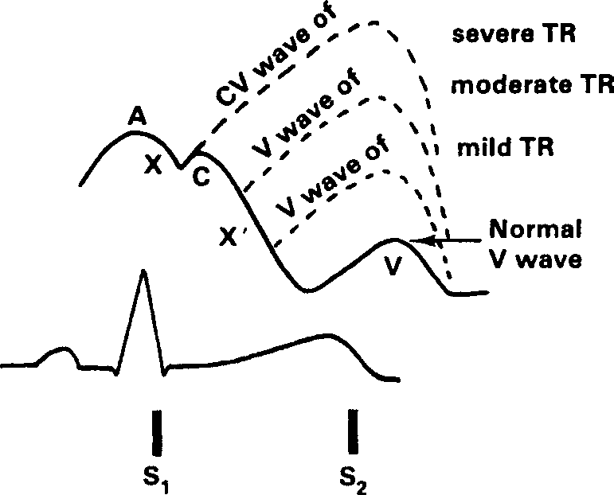
x descent abnormalities (x’ descent)
Usual conditions that can attenuate the X’ descent are
a. Poor RV contraction, as in
RV infarction
Atrial fibrillation /flutter(No atrial presystolic Starling effect stretch)
b. Tricuspid regurgitation (TR)
(because of failure of RA pressures to fall such that the x’ descent is encroached upon in proportion to the degree of regurgitation)

Slide 61
Usual conditions that can increase the amplitude of the X’ descent
Due to vigorous RV contractions (if normal atrial relaxation (No AF) and normal tricuspid valve)
a. Increased volume in the RV such as
Atrial septal defect (ASD)
Pulmonary regurgitation
Anomalous pulmonary venous connection
b. Cardiac tamponade.
c. Constrictive Pericarditis

Slide 62
v wave abnormalities
Large v wave
Reason 1: Excessive right atrial filling (increase in volume)
Reason 2: Loss of compliance of the right atrium (increase in pressure)
A)Excessive right atrial filling
1)RV : TR
2)LV: VSD with LV to RA jet ( Gerbode VSD)
ASD with MR
3)Artery: RSOV, Coronary AV fistula
4)Vein: APVC

Slide 63
Loss of compliance of the right atrium
Outside the heart
Eg: constrictive pericarditis
Inside the heart
Eg:a)Atrial Tumors/Thrombus
b) Elevated diastolic pressures in the atrioventricle due to the
RV hypertrophy (pulmonary outflow obstruction)
Rt heart failure
RCMP
Diminished v wave
Decreased venous return
Hypovolemia
Venodilators
Absent V wave
SVC obstruction

Slide 64
Y descent abnormalities
Y descent is due to RA blood passively moving into RV
Absent y descent: occur when RV is fully compressed at this stage (Cardiac tamponade)
Slow y descent: RA blood moving to RV slowly against resistance:
1. TS, RA Myxoma
2.Increased RVEDP (RVF,RVH,PAH,PS)

Slide 65
Rapid y descent: RA blood rapidly moving in to RV
Causes: if previous venous filling pressure of RA is high (Causes of large v wave)
a)Excessive right atrial filling(TR, ASD, APVC)
b) Loss of compliance of the right atrium( Constrictive pericarditis, RCMP, RVH, RVF

Slide 66
If you see a prominant v wave
1) Tricuspid regurgitation
2)ASD with MR
3) VSD with LV to RA shunt (Gerbode VSD)
4) RV Failure
5) PAH/ Corpulmonale

Slide 69
Peculiarities of v wave in TR
Classic cause of enlarged V wave is TR
V wave in TR , sometimes referred to as C-V wave begins earlier in systole than the usual V wave
when it is prominent, it can simulate carotid artery pulsation
They may even be palpable
Giant V waves frequently cause systolic movement of earlobes, head bobbing , pulsatile liver and pulsatile exophthalmos.

Slide 70
Normal a wave
Attenuated or Absent x descent
Prominant v wave (CV wave)
Rapid and prominant y descent

Slide 71
Atrial Septal Defect
There is left atrialization of the jugular venous pressure (a wave= v wave).
Prominant x descent
Rapid Prominant y descent
If there is an associated MR, v wave becomes more prominant (d/d: TR)
TR: Absent x descent with rapid y descent
ASD with MR: Double descent
Double Descent (d/d:Constrictive Pericarditis )

Slide 72
In an ASD, mean JVP is not elevated
Elevated JVP may be seen in severe PAH and associated RV failure
If prominant a wave: associated TS or MS
If prominant v wave: associated PAH or RVF
If prominant y descent: associated RVF or TR

Slide 73
RV Failure
Mean JVP is elevated
a wave is prominant
x descent is diminished or absent
v wave is prominant (larger than a wave)
Slow y descent
If associated with TR: Rapid y descent.

Slide 74
JVP in PAH
A)Early stages (Associated RVH but no RVF)
Mean JVP may be elevated
Prominant a and v waves
Slow y descent
B)If there is associated RVF
Prominant a and v wave with v wave larger than a wave
x descent is diminished or absent
Rapid y descent due to associated TR

Slide 75
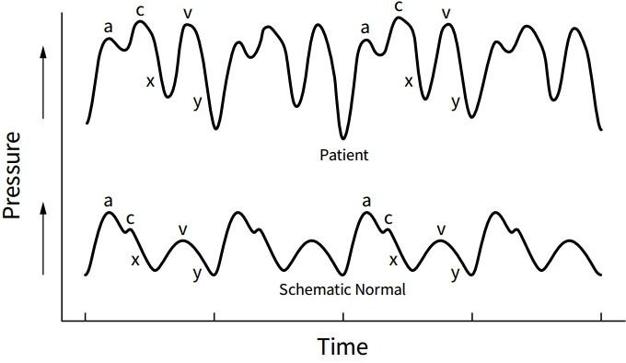
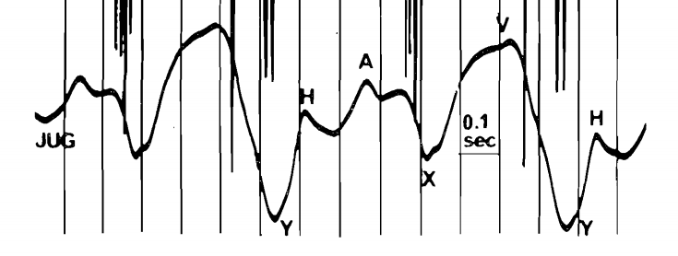
Constrictive Pericarditis
Mean JVP is elevated
a wave is usually normal
v wave is equal to a wave
x descent is prominant
y descent is rapid
Kussmauls Sign is Positive
Double descent/W pattern

Slide 76
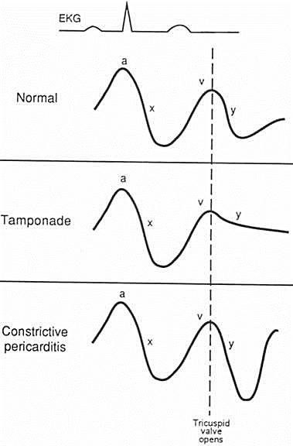
Cardiac Tamponade
Mean JVP is elevated.
a wave normal.
v wave is normal.
x descent is sharp and prominant.
y descent is absent.
Kussmauls sign is absent.

Slide 77
JVP in arrythmias
Normal sinus rhythm is characterised by sequential a and v wave.
Any disturbance in this indicate a rhythm abnormality.
Sinus | a-v regular
1⁰ AV block | Prolonged a-c interval
Wenkebachs | Gradual prolongation of a-c interval
Mobits Type II block | Constant a-c interval with a sudden skip of carotid pulse
CHB | Irregular cannon a waves
Junctional tachycardia | Regular cannon a waves
VT | Irregular cannon a waves

Slide 78
JVP in AF
absent a wave
1st positive wave is C wave
x descent is diminished
v wave is often prominant
Prminant y descent
cxvy
d/d of TR
Irregularly irregular

Slide 79
When you cant find a JVP with elevated CVP

Slide 81
Large a waves
Cannon a waves

Slide 82
Tricuspid regurgitation
Constrictive pericarditis

Slide 83
Atrial fibrillation

Slide 84
THANK YOU

